Slide 1
Power Point
Introduction
Power Point is a presentation composed of a set of screens (also called pages or slides) that you present to people in a room or over the internet.

Slide 2
Purpose of Power Point
The primary purpose of power point is to enable you design, create and edit presentations and printed handouts to your audience.
Wide variety of defined templates are provided by power point to help you produce a good-looking presentation.

Slide 3
Contd.
Note:
The term ‘presentation’ in power point refers to a collection of slides or pages of an individual screen in that presentation.

Slide 4
Kinds of Information Power Point Slides Can Hold
Data: Text, Chart, Graph, Graphics, etc.
Word Document
Live data from internet, complete web pages
Excel worksheets
Multimedia contents, e.g. Video and sound file

Slide 5
Planning Your Power Point Presentation
Tips: When planning your presentation think about your target audience; that is the kind of audience you plan to present an information to determines the layout, slide showing , etc about your presentation

Slide 6
Power Point 2007 Window
Outline
Slide Preview
Slide
Presentation Notes
Change View
Zoom in or out

Slide 7
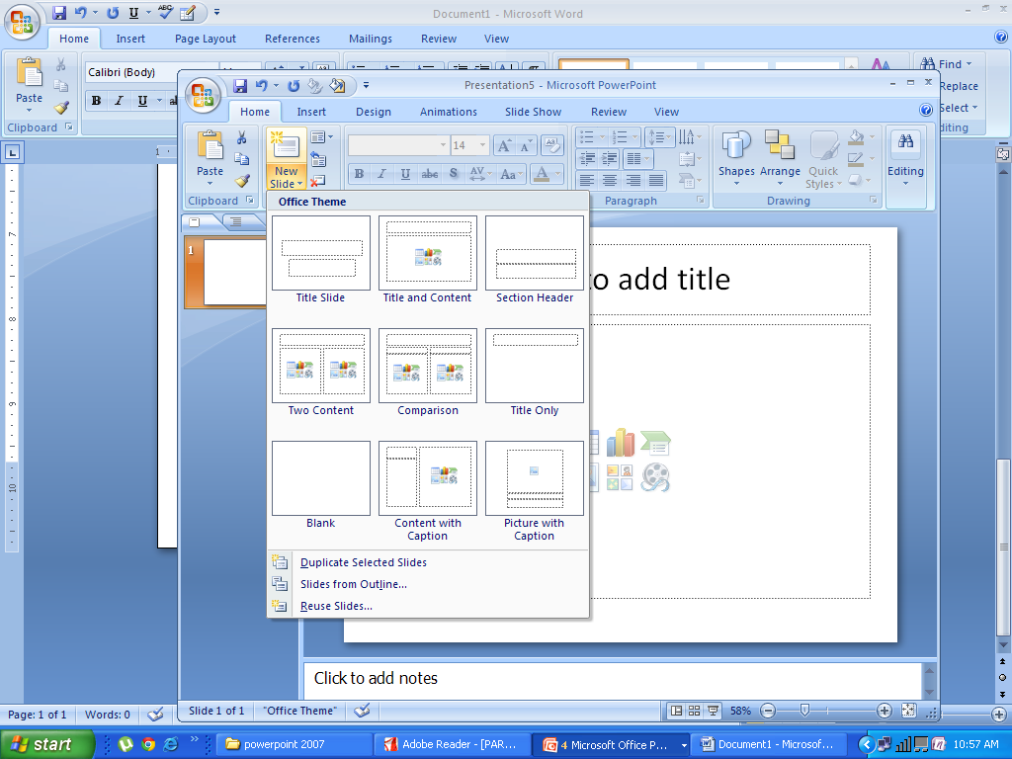
Creating Presentation in Power Point
Click to Display Layouts
New Slide
First Slide
Subsequent Slides will appear here

